Slide 1

SIMCo 2026-27
Economic and Market Outlook
Sources: Bank Credit Analyst, Bureau of Economic Analysis (BEA), Bureau of Labor Statistics (BLS), Capital Economics, Federal Reserve Bank, Goldman Sachs, IMF, Morgan Stanley, OECD, Office for National Statistics (ONS), S&P.

Slide 2
Executive Summary
Global growth expected at 3.0% in 2026 and 3.4% in 2027 (post-2000 annual average 3.5%), shaped by two offsetting factors: negative supply shock of war and positive technology shock caused by AI. Headline inflation to increase in 2026 to 4.7% vs. 4.1% in 2025, then fall to 3.9% in 2027.⁽¹⁾ Global sell off in duration as markets re-price government fiscal risk and respond to recent higher energy prices.
Global backdrop
United States
United Kingdom
Euro Area
Labour market slightly weak but probably in balance.
Headline and core inflation to normalise in 2027.
Market expects 1 ½ 25 bp hikes by mid 2027 and then easing in 3Q27.
Earnings growth very strong, broad-based and supporting equity prices.
Treasuries have sold off on fiscal concerns, energy prices and supply. Lower inflation and Fed under-delivering on rate increases needed to reverse this.
Credit market in good shape, but high yield expected to trade moderately wider by end-2026.
Huge IG issuance by hyperscalers. AI spreads +25 bps vs. non-AI spreads.
Increasing concern over AI bubble bursting due to stretched valuations and growing AI debt levels.⁽³⁾
Economic growth fragile but better than expected.
Labour market and payroll growth remain weak.
Headline inflation to peak in 2H2026 and core continues to ease.
Improving growth-inflation mix. Inflationary expectations anchored.
Primary fiscal budget expected to improve between now and 2030.
Gilt prices suffering more than other major economies from global bond market weakness in July-September, despite not being relatively worse off.
Equities supported by low valuations and solid RoE.
Growth steady and more resilient than expected.
Core inflation up moderately in 2026, expected flat in 2027 and moderately down in 2028.
Unemployment near all-time low.
Asia Pacific
Region hurt by energy shock but helped to larger extent by strong participation in AI value chain.
BoJ has raised policy rates on back of higher inflation and weak yen.
Strong non-Japan Asia AI-related growth in 2025-26 to normalise in 2027.⁽²⁾

Slide 3

United States
Economic and Market Outlook

Slide 4
Macro Outlook: US Economy on Fairly Solid Footing
GDP growth good but consumer weakening
FORECAST
Unemployment rate low but hiring also low
FORECAST
Real GDP (% annual change, LHS) | Real consumer spending (% annual change, RHS)
Unemployment rate (%, Q4 avg, LHS) | Non-farm payrolls (avg. monthly change, '000s, RHS)
Real GDP (LHS)
Consumer spending (RHS)
8
Unemployment rate (LHS)
Non-farm payrolls (RHS)
800
7
9
+606
5.8%
8.8%
7
6.7%
5
400
2.8%
3.0%
2.6%
3.4%
6
6
+377
3
1.3%
2.4%
2.0%
2.1%
2.2%
+176
+190
+165
+210
+122
0
3
5
+20
+41
+75
1
2.6%
2.7%
2.4%
-1.0%
3.0%
2.6%
2.9%
2.6%
2.1%
2.1%
4.1%
4.2%
4.1%
4.5%
4.3%
4.3%
0
4
3.8%
3.6%
3.6%
3.8%
-400
-1
-2.5%
3
-770
-800
-3
-3
2017
2018
2019
2020
2021
2022
2023
2024
2025
2026E
2027E
2017
2018
2019
2020
2021
2022
2023
2024
2025
2026E
2027E
Post-2000 average annual GDP 2.1% and consumer spending 2.5%.
Sources: BEA actuals; Philadelphia Fed Survey of Professional Forecasters (SPF) (Q3 2026) forecasts.
Post-2000 average annual unemployment rate (ex. Covid) 5.5% and non-farm payrolls 103,000/mo.
Sources: BLS actuals; Philadelphia Fed SPF (Q3 2026) forecasts.
GDP growth bolstered by investment spending
Labour demand low but in balance with recent labour force contraction
Manufacturing up eight months in a row (ISM Index).
Business investment strong with 100% expensing. Up 5.4% in 1H2026. 2026E +7%.
Consumer spending (67% of GDP) slowed to +1.8% in 1H2026 and is expected to slow to 1.0-1.5% in 2H2026 on weak wage growth, higher gas prices and a waning tax refund boost. Post-2000 consumer spending average (ex. Covid) 2.5% pa.
Productivity has improved vs. early 2010s, but not yet in early 2000s-style boom.⁽¹⁾
2026 non-farm payrolls 41k/mo. historically soft, but not necessarily weak because of recent low labour-force growth.⁽²⁾ August +133k in payrolls vs. 55k expected. Sept. +29k.
Labour force strong in 2023-25 but contracted in 1Q and 2Q 2026 on less immigration, aging population and lower participation.
Breakeven employment growth down: 155k/mo. 2023-24, 85k/mo. 2025, 10-50k 2026E.⁽³⁾
Job openings ratio 1:1 most of 2026 -- suggests US labour market is in balance.⁽⁴⁾

Slide 5
Macro Outlook: Inflation Expected to Normalise
Headline and Core Inflation Firmer in 2026
FORECAST
Fed Funds Rate
FORECAST
PCE inflation, annual % change
Federal funds effective rate, year-end %
Sources: BEA actuals; Philadelphia Fed Survey of Professional Forecasters, Q3 2026.
Sources: Fed actuals; market forecasts CME Fed funds futures; GS/MS mean forecasts.
Inflation expected to soften in 2027 on the back of a balanced labour market, strong USD, and “as the effects of tariffs and earlier energy price increases wane” (FOMC July minutes).
Headline PCE peaked at 4.1% in May 2026 and fell to 3.4% (0.3% m/m) in August 2026.
Core PCE expected at 3.1% in 2026 and then to ease to 2.2% in 2027 vs. 3.0% in 2025.⁽¹⁾
Energy (so far) primarily a headline effect with limited second-round effects on core.⁽²⁾
Market expects Fed to raise rates 34 bps in 2026 and 25 bps by mid-2027, before lowering in 3Q2027. This would leave rates in restrictive territory vs. an estimated neutral rate of 3.25-3.5%.
GS expects a 25 bp hike in September and October 2026 and a decrease of 50 bps in mid/late 2027 on slow employment growth and lower inflation.
Jackson Hole: Warsh’s emphasis on inflation, commitment to 2% target, and statement that policy rates are main tool to get there flattened the curve and increased Fed credibility.

Slide 6
Market Outlook: Strong Earnings, Term Rates Sell Off
KEY TRENDS
Strong Earnings Momentum
Heavy AI Capex-Related Supply
Yields Rise / Politics to be Divided
I.
II.
III.
Double-digit headline earnings growth for seven consecutive quarters.
S&P 500 headline EPS growth: 1Q +29% and 2Q +32%, excluding the Magnificent 7.⁽¹⁾
Positive 2026/27 revisions. Full-year 2026E and 2027E headline EPS +24% and +17%. Strong support for equities.
12-mo. forward S&P 500 P/E: 20x, in line with the 5-yr average of 19.9x.⁽²⁾
Strong earnings have helped cash flows at the aggregate level:
S&P 500 net debt / EBITDA leverage healthy at 2.1x now vs 4-5x in the early 2000s. Interest coverage strong at 5x now, down from 7-8x in 2021-22, but higher than 3x in 2000-02.
Hyperscaler issuance heavy. Capex only borrowing:
AI-related borrowing expected to be nearly 40% of corporate supply in 2026 and reach $570bn with another $420bn expected in 2027.
This would far outstrip senior bank issuance of $300-330bn expected in 2026.
It’s expected that hyperscalers alone can issue an additional $1tn in debt from 2025 levels and stay IG. This would take the group to 2x net leverage. They are currently at 0.5x.
AI IG spreads +25 bps wider vs non-AI IG since just before the June-July 2026 AI sell-off.
Fiscal risks + energy volatility + AI borrowing boom drove long-end yields to 20-year highs.
July-Sept. sell-off due to increase in term premium from fiscal risks and an increase in inflation premium from higher energy prices.
GS head of government bond trading: “Near term could see higher yields but constructive on medium and longer term. 10-year real yields at 25-year highs. Inflation should normalise.”
Net, net: a bull steepening curve into 2027 expected after 90 bps of flattening YTD in 2026.
Midterm elections not expected to have a major effect on markets or economy. Consensus is for a divided government.
Prediction markets -- Dems 85% for winning House but Senate control is a coin-toss (51%/49% Rep/Dems).⁽³⁾
  2025A 27% of capex or $100bn
  2026E 33% of capex or $250bn
  2027E 35% of capex or $400bn

Slide 7
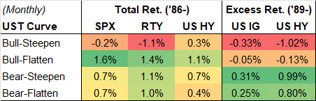
Market Outlook: Spreads Well Supported but Risk to Widening on Supply
Credit fundamentals are good
How credit has historically behaved as the US Treasury curve changes. After flattening throughout 2026, steeper curve likely into 2027 but needs lower energy prices and lower inflation.⁽⁴⁾
Credit spreads well supported by fund flows, foreign demand, and higher rates bringing in yield buyers (real money investors).
Distress ratio low at 4.6% vs. post-2000 median of 7.4%.⁽¹⁾ For comparison, peak 85% in Dec. 2008 and low 1.6% in Dec. 2006.
US investment grade to do the heavy lifting on hyperscaler issuance. A lot of runway to add debt ($1tn before investment grade ratings pressure).
BB/Bs 9 bps tighter YTD; CCCs 216 bps wider and only 9 bps from their 12-mo. wides.⁽²⁾
Defaults moderate, refinancings manageable
What this means
S&P base case global 12-mo. speculative-grade defaults expected at 3.8% for March 2027, up from 3.1% for March 2026. Post-2000 average 3.7% (range: 0.9-9.9%).
US defaults 4% vs. 3.8%; Euro area 3.75% vs. 3.1%; Asia-Pacific 2.25% vs. 0.8%. US outperformance due to less shock from energy prices, whereas Asia-Pac underperforms.
US leveraged finance refinancing wall $1.2tn between 2027-29.⁽³⁾ Most consider this manageable with the current market.
AI/data centre debt shifts from scarcity premium to supply discount. The sector is 19% of high yield issuance to date. Only one deal trades above OID.
Heavy AI issuance + higher rates challenging definitions of quality, weighing on strongest cohorts: BBBs outperforming AAs and As, and Bs outperf. BBs.
GS expects high yield spreads to widen moderately in 2H2026 and credit curves to steepen on heavy AI supply.
Sell-off in rates due to market re-pricing of monetary policy expectations, fiscal concerns, and government and AI-related corporate supply.
Further material sell-off in rates not expected, but unlikely to reverse course until inflation cools and central banks underdeliver vs. what's priced in.

Slide 8
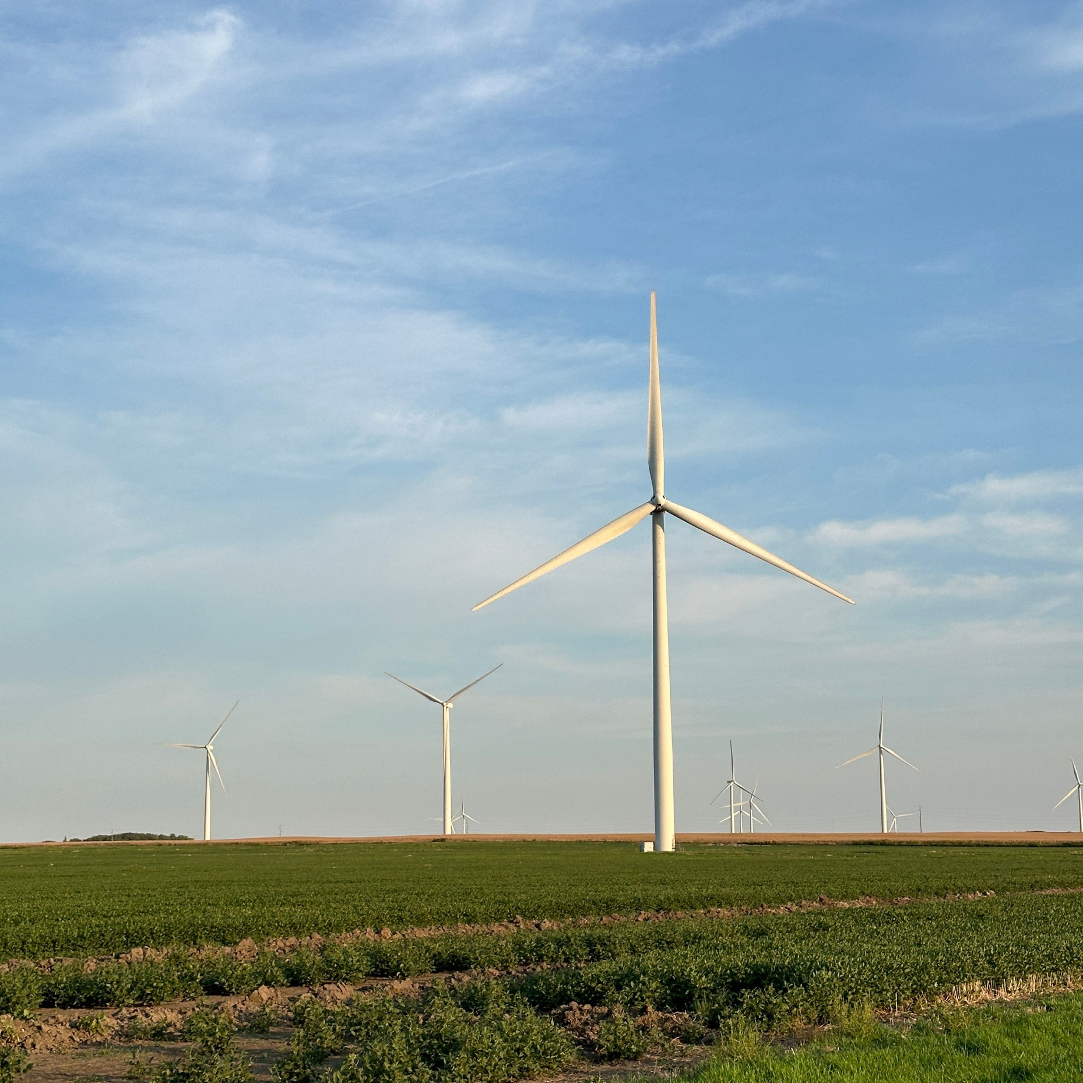
United Kingdom
Economic and Market Outlook

Slide 9
Macro Outlook: Improving Growth-Inflation Mix
Real GDP Growth
FORECAST
Unemployment Rate
FORECAST
Annual % change
Annual % change
Sources: ONS; OECD Economic Outlook. Average post-2000 1.7%.​
Sources: ONS; OECD Economic Outlook. Average unemployment rate post-2000 5.4%.​
Macro backdrop weak but better than expected
Weak labour market and low real wage growth are the drags on GDP
Economy fragile but investment outlook improving. Slower growth, more dovish BoE to support Gilts going forward.⁽¹⁾ UK equities benefiting from high RoEs and low valuations.
UK entered the Middle East-related shock with recessionary signals already flashing red.
1H2026 GDP +0.4% -- economy weathered energy shock better than expected. 2026E GDP 1.2%, 2027E 1.4%. UK has a high beta to energy.^{(2)​}
Manufacturing and exports are bright spots. September PMI 52, so expanding. Service exports at record real levels. Big issues of low investment and low productivity remain.
June-August average monthly job vacancies 702k, lowest in 12 years (ex. Covid). May-July unemployment rate 4.9%, up from 3.8% in 2022, a 50-yr low.
Payrolled employee growth negative in seven of the last 12 months. 2025 and 1H2026 weakest periods in last 10 years except for Feb. 2020 to Nov. 2020 (lockdown).​
Private sector nominal earnings growth 2.9% (May.-July 2026) or -0.1% real. Weak vs. post-2000 average real growth of 1% pa.​
Sahm Rule triggered in 2025, peaked at 80 bps and has since declined (i.e., strengthened) to 20 bps -- may hint at UK growth.

Slide 10
Macro Outlook: Core Inflation to Moderate into 2026-27
Headline and Core Inflation
FORECAST
Bank Rate
FORECAST
Annual % change
Year-end %
Sources: ONS; OECD Economic Outlook; HM Treasury, Forecast for UK Economy, Aug. 2026​
Sources: Bank of England actuals; market forecasts implied overnight rate; GS forecasts.
Inflation to soften in 2027
Bank Rate already restrictive. Gilt term premium very high​
Medium term market-based inflation expectations anchored.^{(1)​}
Headline CPI expected to peak in 4Q2026 at 3.7% (GS 3.3%) and core expected at 2.3% end-2027, as services inflation cools further in 2027 from easing labour cost growth.⁽²⁾
Core goods to accelerate in near term but start to ease in mid-2027 on lower energy prices and easing distribution sector cost growth.
Market expects 25 bp hike in 2026 and a 25 bp hike in March 2027 to 4.25%.​ This would leave the Bank Rate quite restrictive vs. an estimated neutral rate of 3%.
​
GS expects BoE to hike 25 bps in December and then cut 75 bps in 2027-28 on easing price pressures in 2027, a weak labour market, and starting from high, currently restrictive rates.​
​
Gilt prices penalised by residual mini-budget factors and large term premiums, despite improving growth-inflation mix and declining country risk premium.⁽³⁾ Lower yields possible in 2027 from front end support, increasingly dovish BoE, and expectation of an improved fiscal budget between 2026-2030.⁽⁴⁾

Slide 11

Euro Area
Economic and Market Outlook

Slide 12
Macro Outlook: Growth Shows Signs of Resilience
GDP
FORECAST
Unemployment Rate
Real GDP, annual % change
FORECAST
FORECAST
Harmonised annual average % for EA20 aggregate
Sources:
Source: ECB. Post-2000 average annual GDP 1.3%.
Source: Eurostat historical and ECB for forecasts.
Growth better than expected
Euro area unemployment near all-time low
Euro area growth more resilient than expected despite large energy shock. Recent data -- including 2Q GDP, PMIs and rising data surprise index -- point to momentum.⁽¹⁾
Structural features supporting growth: lower energy dependence, growth-friendly fiscal policy, robust household finances and supportive financial conditions.⁽²⁾
This resilience echoes 2022-23 when Euro area economy avoided a significant contraction despite a historic energy shock.
2026E +0.8% and 2027E 1.2% by ECB staff vs. 1.5% in 2025.
Labour markets have remained resilient despite sub-potential growth.
Nominal wage growth, expected at 3.2% in 2026, is supporting ongoing gains in household real income of 0.3%.
Combined with elevated household savings at 14.3%, this provides a supportive backdrop for household finances.
Consumer spending expected to have continued rising since the start of the war, despite higher inflation.

Slide 13
Macro Outlook: Inflation Cooler than Expected, Market Prices Rate Hikes
Headline and Core Inflation
FORECAST
Deposit Rate
FORECAST
HICP inflation, annual average %
ECB deposit facility rate, year-end %
Sources: ECB for historical and projections.
Sources: ECB historical; market forecasts overnight index swaps; GS forecast.
Inflation cooler than expected but still too high
Rate hike in September fully priced in; market expects more in 2027
Inflation currently running lower than projected earlier this year, but still above target and not expected to reach 2.2% headline and 2.3% core until 2027.
Euro area consumer price expectations for the next 12 months have eased from 48.7 in April 2026 to 36 in Aug. 2026, up from 26 in Feb. pre-Middle East conflict.⁽¹⁾
ECB staff expects headline running at 2% in 2H2027 as direct energy effects fade, but this may be adjusted up with most recent rise in energy prices.
The renewed rise in energy prices -- especially gas -- points to firmer headline inflation.
September hike of 25 bps to 2.5% is widely expected, following the June 25 bp hike.
Markets are pricing two additional hikes by mid-2027, leaving the deposit rate at 3%, reflecting a longer-term energy shock. This would leave the deposit rate in restrictive territory vs. the estimated neutral rate of 2%.
GS expects the ECB to hike 25 bps in December 2026. They then expect the ECB to lower rates in 2027-28 based on energy prices eventually moderating and the inflationary effects of the energy shock proving more temporary, with limited wage and core-inflation spillovers.

Slide 14

Randall Sandstrom
r.sandstrom@SIMCoFunds.com
Manuela Mady
m.mady@SIMCoFunds.com
10 Lower Grosvenor Place,
London,
SW1W 0EN
www.SIMCoFunds.com

